Slide 1
Bankruptcy Forecast
1
the Future of Taiwanese Company bankruptcies:
Prepared and Presented by:
Alejandro Gomez
Jessica Dean
Stacey Boyce
Brook forrester
Becca Stilley

Slide 2
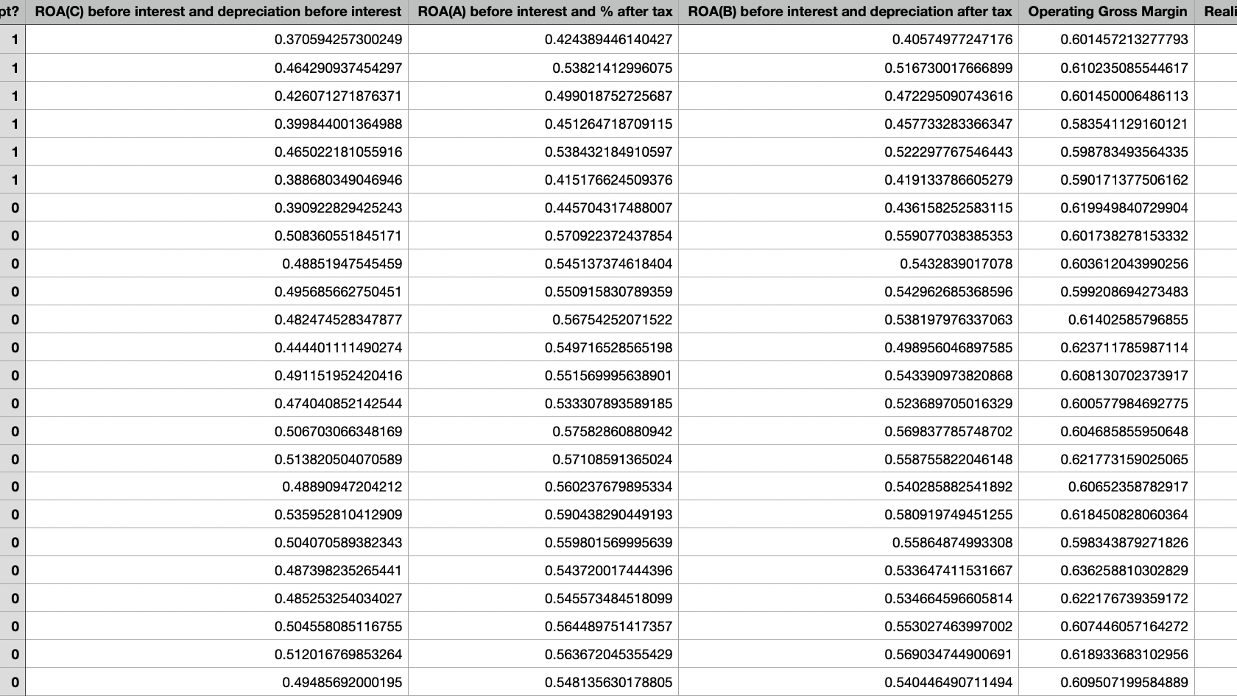
Original Dataset
2
Bankruptcy data from the Taiwan Economic Journal for the years 1999-2009, Stock exchange dataset

Slide 3
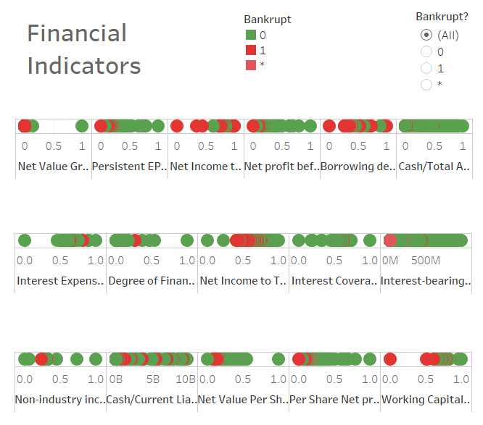
Background on the Dataset
3
The Taiwanese Stocks consist of about 2500 different companies including those that have gone bankrupt between 2009 and 2019
The original dataset had 96 financial indicators
Includes indicators for Bankrupt, In the Process of becoming bankrupt, and Not Bankrupt

Slide 4

What is it, and how does it Happen?
4
Legal process that involves a person or business that is unable to repay their outstanding debts.
All the debtor's assets (property, gifts, land, etc.) are measured and evaluated; the assets may be used to repay a portion of outstanding debt.
Does not necessarily mean complete dissolution of company
Chapter 11- reorganization of assets/company debt

Slide 5
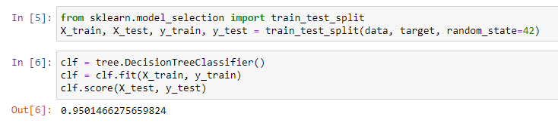
Data Cleaning
5
We asked ourselves can we predict using the data to determine if a company is likely to go bankrupt
Dataset was clean and consistent to begin with, in terms of missing data
Our Process:
Used Pandas to read CSV file
Used Sklearn in Jupyter Notebook to import tree and score getting a 95%

Slide 6
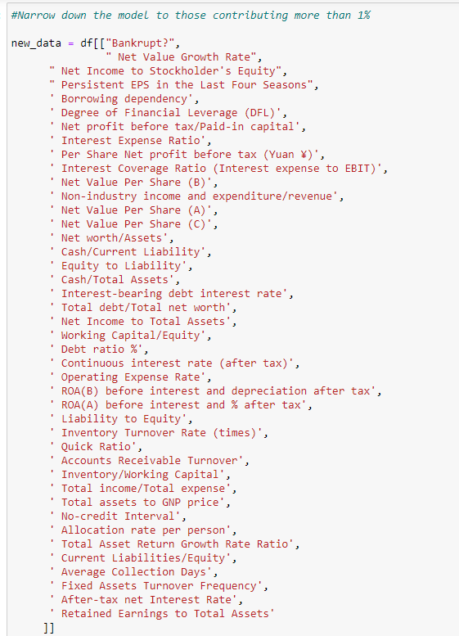
There were originally 95 different parameters, so we decided to use feature importance to determine which parameters were relevant
We kept 41 parameters, and removed anything contributing to less than 1% to that importance factor
We then tested the model with the 41 relevant indicators that resulted, and we did not lose much integrity with our data (0.1%)

Slide 7
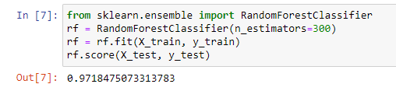
Our Process Continued…
Used Random Forest Classifier and obtained a score of 97.18% after trying with different numbers of estimators,

Slide 8
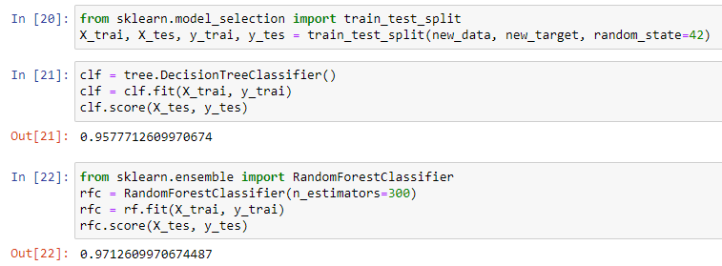
Decreasing Parameters

Slide 9
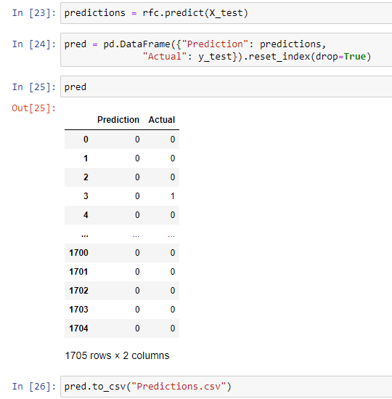
Prediction vs. Actual
Ran prediction vs actual in data frame and exported to a csv to double check.

Slide 10

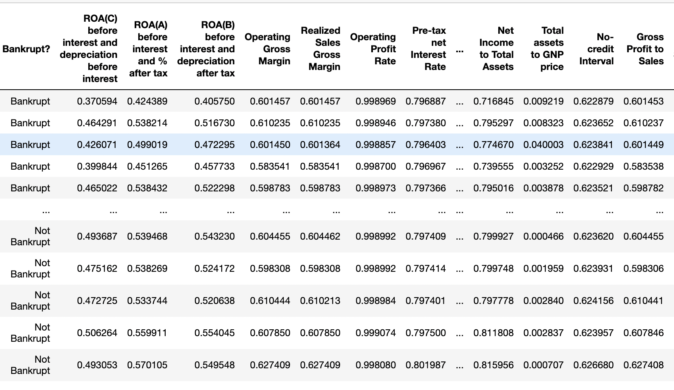
Our Cleaned Dataset
6

Slide 11
So, what does the Data look like?
We chose to use Tableau to visualize our data.
Tableau is an intuitive tool that allows you to produce multiple visuals quickly.
We realized that the lack of identifiers for the companies in the dataset was problematic because we didn’t have enough information for our axis’ to graph
To troubleshoot this, we used pandas to add the index as a column so that each row (Company) had a unique identifier.
We also changed the 0 or 1 in the “Bankrupt?” column to be text instead of string to make the data more useful in Tableau.

Slide 12
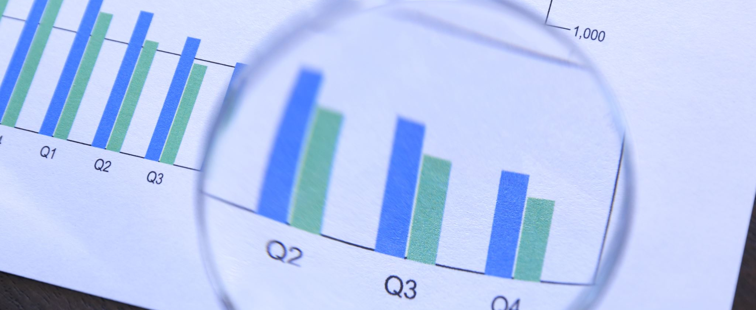
Visualizations
Comparing top prediction ratios for Bankrupt Vs. Non-Bankrupt companies

Slide 13
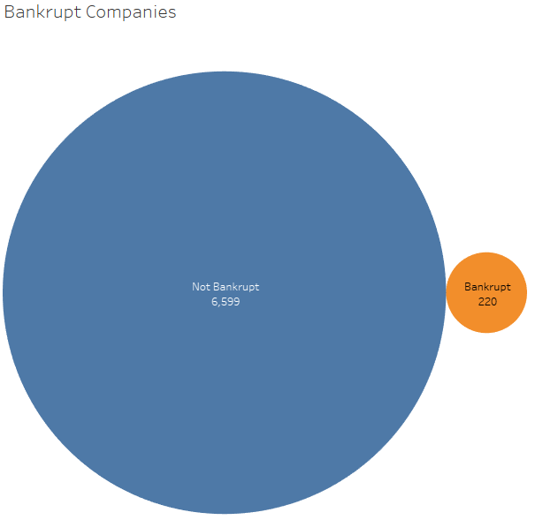
Bankrupt vs. Not Bankrupt 1999-2009
7
Over 10 years, only 3.33% of companies filed for Bankruptcy in Taiwan

Slide 14
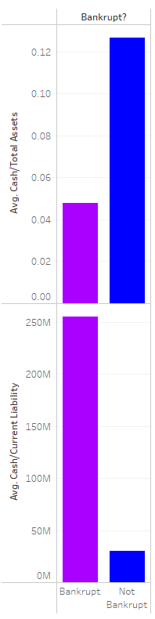

Slide 15
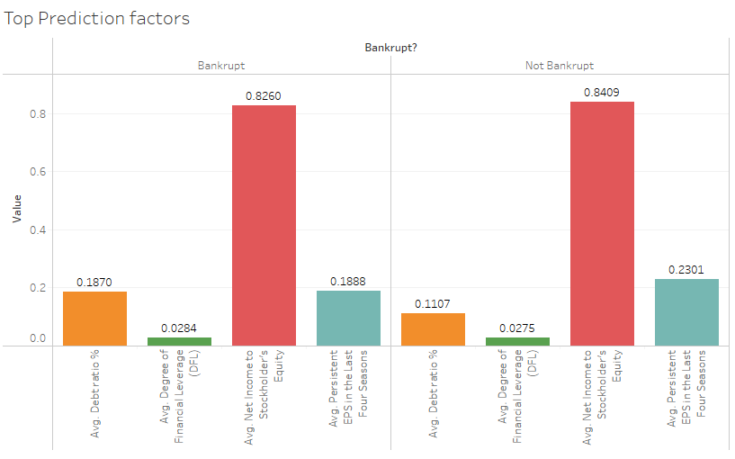
Prediction Factors

Slide 16
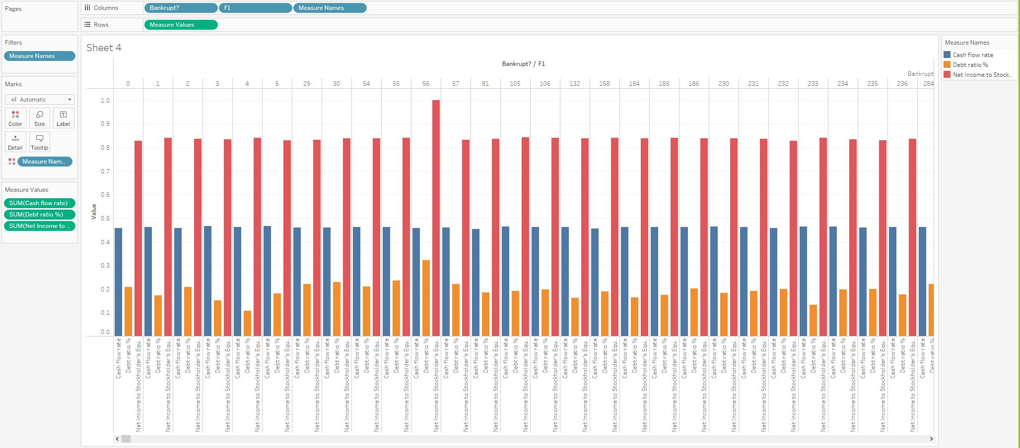

Slide 17
What We Learned
9

Slide 18
Roadblocks
10
The dataset did not detail individual company names which made it more difficult for us to generate detailed visuals in Tableau
The data was combined for all 10 years, rather than listing out each company per year.
Our dataset was specific to Taiwan, which was difficult to find supplemental data to compare.
We looked for other datasets, but there were no other viable sources

Slide 19
References
12
https://www.kaggle.com/fedesoriano/company-bankruptcy-prediction
https://public.tableau.com/app/profile/alejandro.gomez5182/viz/Bankrupcy/Dashboard1

